Slide 1

Bankruptcy Prediction Using Machine Learning
Satya Vrat Singh
Notes:
The biggest calamity that can befall equity investors is corporate bankruptcy, which wipes out the equity of a firm and knocks the stock's investment value down to zero. Fundamental analysis attempts to gauge the financial strength of a company using a variety of metrics. Used in conjunction with one another, financial ratios can often help us to paint a picture of the long-term viability of a firm.

Slide 2
Agenda
Defining the Problem Statement
Get the data
Exploratory Analysis
Data Pre-processing
Build models-Hyper Tuning
Feature Engineering
Predictions
Analysis
Future Scope

Slide 3
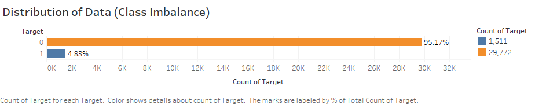
Exploratory Analysis
Notes:
SMOTing
Handling NA values

Slide 4
Data Pre-processing
Column drop – ID
Datatype conversion
Imputation - kNN
SMOTE : Synthetic Minority Over-sampling Technique

Slide 5
Models-Hyper Tuning
Decision Tree : C5.0
Decision Tree : RPART
Random Forest
Random Forest Feature selection
Random Forest with mtry=10:20
Random Forest Feature selection (mtry=19)
Random Forest Feature Engineering (mtry=19)
SVM – Linear

Slide 6
Predictions
Model Name | Performance Metric |  |  | Model Name | Performance Metric |  |  | Model Name | Performance Metric
 | Test Data |  |  |  | Test Data |  |  |  | Test Data
DT_C50 | Recall | 0.6983051 |  | DT_RF_Imp | Recall | 0.928098 |  | RF_tune_featureng | Recall | 0.926522
 | Precision | 0.8445285 |  |  | Precision | 0.759484 |  |  | Precision | 0.513636
 | Specificity | 0.8334459 |  |  | Specificity | 0.742826 |  |  | Specificity | 0.23234
 | Accuracy | 0.7571744 |  |  | Accuracy | 0.829286 |  |  | Accuracy | 0.556291
 | F1 Score | 0.7644876 |  |  | F1 Score | 0.835368 |  |  | F1 Score | 0.660893
DT_rpart | Recall | 0.7127294 |  | RF_tune (mtry=19) | Recall | 0.923683 |  | SVM-Linear | Recall | 0.592873
 | Precision | 0.7839798 |  |  | Precision | 0.759399 |  |  | Precision | 0.753809
 | Specificity | 0.7928636 |  |  | Specificity | 0.743929 |  |  | Specificity | 0.830574
 | Accuracy | 0.7517292 |  |  | Accuracy | 0.827815 |  |  | Accuracy | 0.719647
 | F1 Score | 0.7466587 |  |  | F1 Score | 0.833523 |  |  | F1 Score | 0.663725
DT_RF | Recall | 0.9230527 |  | DT_RF_Imp (mtry=19) | Recall | 0.922422
 | Precision | 0.74936 |  |  | Precision | 0.764706
 | Specificity | 0.7298565 |  |  | Specificity | 0.751656
 | Accuracy | 0.8200147 |  |  | Accuracy | 0.831347
 | F1 Score | 0.8271867 |  |  | F1 Score | 0.836192

Slide 7
Feature Engineering
Bankruptcy Prediction Models-
Altman Z-score
KMV Merton Distance to Default
Altman Z-score:
Z= 1.2 X1 + 1.4 X2 + 3.3 X3 +0.6 X4 +0.999 X5
X1 = working capital/total assets [Attr3]
X2 = retained earnings/total assets [Attr6]
X3 = earnings before interest and taxes/total assets [Attr7]
X4 = market value equity/book value of total liabilities [Attr8]
X5 = sales/total assets [Attr9]
Notes:
Working Capital/Total Assets (WC/TA) This ratio is a good test for corporate distress. A firm with negative working capitalis likely to experience problems meeting its short-term obligations because there are simply not enough current assets to cover those obligations.
Retained Earnings/Total Assets (RE/TA) This ratio measures the amount of reinvested earnings or losses, which reflects the extent of the company's leverage. Companies with low RE/TA are financing capital expenditure through borrowings rather than through retained earnings. Companies with high RE/TA suggest a history of profitability and the ability to stand up to a bad year of losses.
Earnings Before Interest and Tax/Total Assets (EBIT/TA) A version of return on assets (ROA), an effective way of assessing a firm's ability to squeeze profits from its assets before factors like interest and tax are deducted.
Market Value of Equity/Total Liabilities (ME/TL) This is a ratio that shows – if a firm were to become insolvent – how much the company's market value would decline before liabilities exceed assets on the financial statements. This ratio adds a market value dimension to the model that isn't based on pure fundamentals.
Sales/Total Assets (S/TA) This tells investors how well management handles competition and how efficiently the firm uses assets to generate sales.

Slide 8
Feature Engineering (Binning)
The Zone of discrimination of the scores are as follows,
Z > 2.99 -“Safe” Zone
1.81 < Z < 2.99 -“Grey” Zone
Z < 1.81 -“Distress” Zone
If a company’s Z score is less than 1.81, the chances of that company going bankrupt within two years is high
Note: The Z-score is not a perfect metric and needs to be calculated and interpreted with care. The Z-score also isn't much use for new companies with little or no earnings. These companies, regardless of their financial health, will score low.
Notes:
Strictly speaking, the lower the score, the higher the odds are that a company is headed for bankruptcy. A Z-score of lower than 1.8, in particular, indicates that the company is on its way to bankruptcy. Companies with scores above 3 are unlikely to enter bankruptcy.

Slide 9
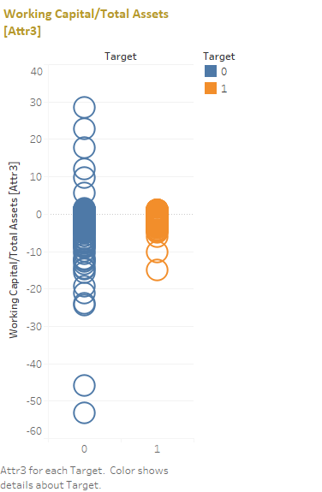
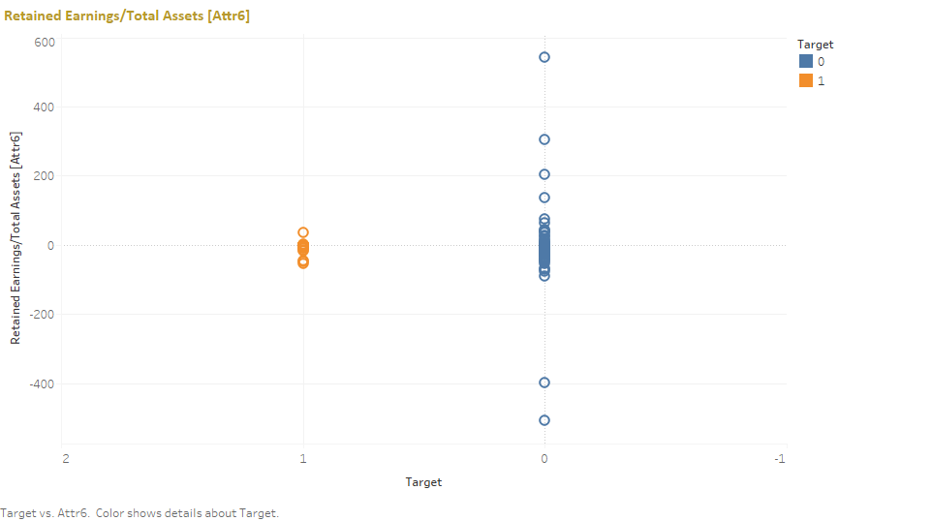

Slide 10
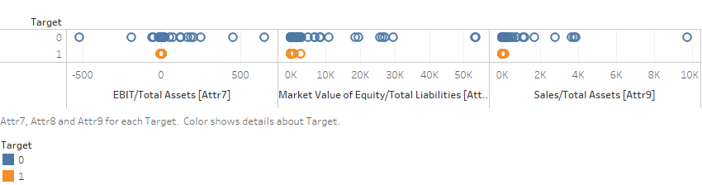

Slide 11
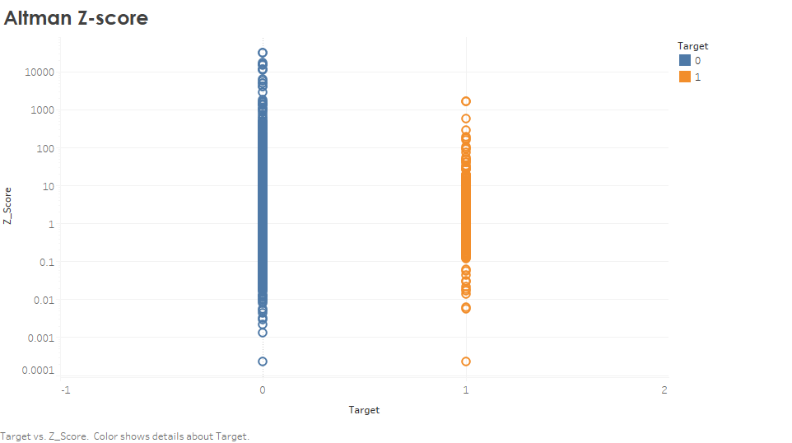

Slide 12
Future Scope
Altman Z-score can be implement in a better way, if more clean data be given

